Slide 1
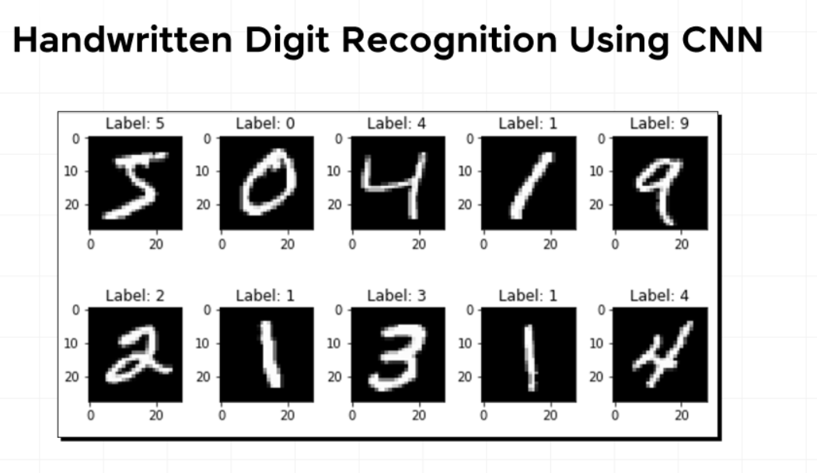
Handwritten Digit Recognition using CNN
Name: Mehak rawat
PBEL Internship Project

Slide 2
Introduction
Handwritten digit recognition is a computer vision problem.
The goal is to recognize digits 0–9 written by humans.
It uses deep learning techniques(CNN).
The project integrates AI with a web application.

Slide 3
Problem Statement
Handwritten digits are difficult to interpret automatically.
Different writing styles create classification challenges.
Manual processing is time-consuming.
Need an AI-based system for automatic digit recognition.

Slide 4
Technologies Used
Frontend
React
Tailwind CSS
HTML Canvas
Backend
Python
Flask
OpenCV
Machine Learning
TensorFlow
Keras
CNN

Slide 5
Dataset (MNIST)
MNIST is a popular dataset for handwritten digit recognition.
Dataset details:
Total Images: 70,000
Training Images: 60,000
Testing Images: 10,000
Image Size: 28 × 28 pixels
Classes: Digits 0–9

Slide 6

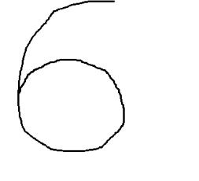
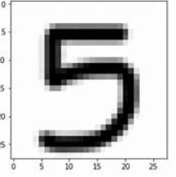
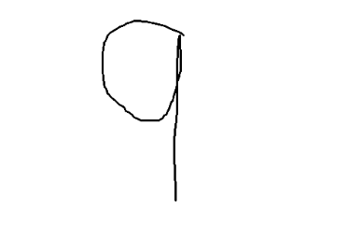
Sample MNIST Images

Slide 7
System Architecture
System workflow:
User draws digit ↓ React Canvas Interface ↓ Image converted to Base64 ↓ Flask API ↓ Image preprocessing ↓ CNN model prediction ↓ Result displayed on frontend

Slide 8
Data Preprocessing
Steps involved:
Capture Image
User draws a digit on the React canvas.
Convert to Grayscale
The image is converted into grayscale format.
Resize Image
The image is resized to 28 × 28 pixels.
Normalize Pixel Values
Pixel values are scaled between 0 and 1.
Reshape Image
Image reshaped to (1, 28, 28, 1) to match CNN input.

Slide 9
CNN Architecture
The Convolutional Neural Network includes:
Input Layer (28×28 image)
Convolution Layer
ReLU Activation
MaxPooling Layer
Flatten Layer
Dense Layer
Softmax Output Layer

Slide 10
Image Preprocessing
Steps before prediction:
Convert image to grayscale
Resize image to 28×28
Normalize pixel values
Reshape image for CNN input
This ensures compatibility with the trained model.

Slide 11
Training Process
Model training includes:
Loading MNIST dataset
Data normalization
CNN training using TensorFlow
Validation using test dataset
Saving trained model

Slide 12
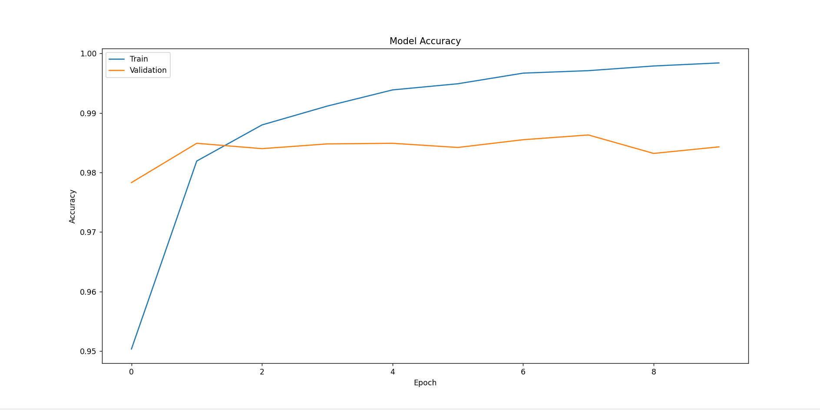
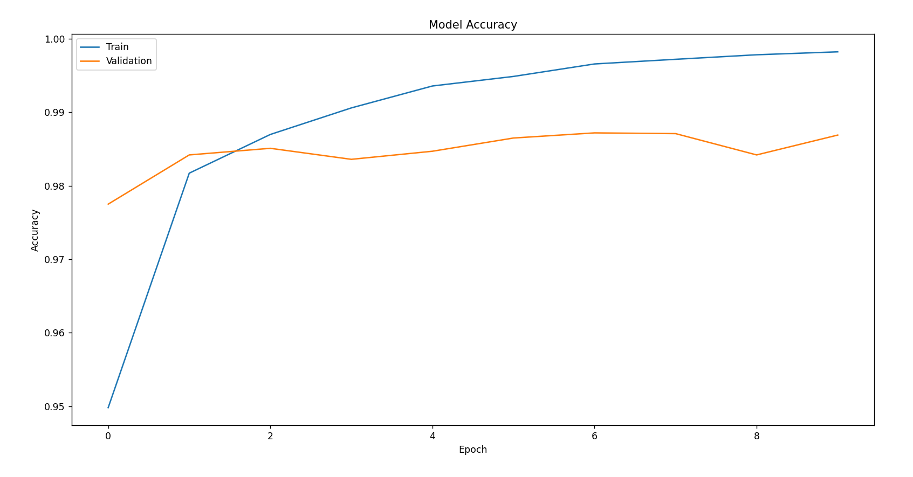
Comparison using graphs(matplotlib)
Accuracy vs Epoch
Loss vs Epoch

Slide 13
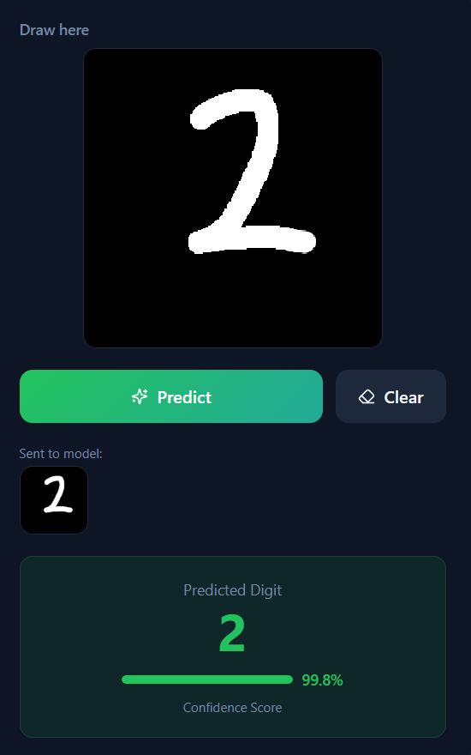
Results
Model performance:
Training Accuracy ≈ 99%
Test Accuracy ≈ 98%
Example:
User draws digit :2 Prediction → 2 Confidence → 99.8%

Slide 14
Application
Handwritten digit recognition is used in:
Bank cheque processing
Postal code recognition
OCR systems
Form digitization
Automated document processing

